Slide 1
SAU 9
All Bartlett/Conway/NonCon/All SAU9/Admin Open Enrollment - July 2022

Slide 2
Zoom Rules
Webinar Mode: Automatically Muted and Camara Is off.
Use the “Chat” feature to ask questions.
At the end, use the “Raise Hand” feature and we can unmute you to ask any remaining questions.
This session is being recorded!
For those watching the recoded version, please be sure to complete the quiz to earn your NHIT Rewards Funds!!
Keep private health information private!

Slide 3
Open Enrollment
Updates & Deadlines

Slide 4
FSA News
FSA Open Enrollment
Election forms to the SAU by June 3, 2022
Benefit Strategies and Voya Co-branding
Website – Voya & Benefit Strategies
App and Debit Card – Benefit Strategies Only
Effective July 1, 2022:
Updated FSA Contribution Maximum - Increased to $2,850
New FSA Rollover - Rollover unused funds up to $570 at the end of the year for the start of July 1, 2023
FSA Debit Cards
Debit Cards expire after 3 years of use
Members will automatically receive a new set of debit cards

Slide 5
How Much Funding?
Year 1 Current
NHIT Funds Individual Up to $1,000 2-Person/Family Up to $2,000
Unused NHIT Funds Rollover
Year 2 2022-2023
Year 3 2023-2024
District Funds
NHIT Funds Individual Up to $1,000 2-Person/Family Up to $2,000
Unused NHIT Funds Rollover
NHIT Funds Individual Up to $1,000 2-Person/Family Up to $2,000
Unused NHIT Funds Rollover
2-Person/Family $1500
Individual $500
Unused District Funds Roll into 2022-2023
District Funds do not get replenished
Unused funds from 2021-2022 and 2022-2023 are rolled into 2023-2024
District Funds
Individual $500
2-Person/Family $1500
Unused District Funds Roll into 2023-2024
Maximum Balance Allowed: Individual $2,000 2P/Family: $4000
Maximum Balance Allowed: Individual $2,000 2P/Family: $4000

Slide 6
Eligible Expenses
Year 1 Current
NHIT Funds Deductible/Coinsurance Medical and Rx Expenses
Year 2 2022-2023
Year 3 2023-2024
District Funds
(New & Rollover)
Deductible/Coinsurance Medical and Rx Expenses
District Funds
FSA (213d) Eligible Items and Expenses
District Funds
(New)
Deductible/Coinsurance Medical and Rx Expenses
NHIT Funds (New & Rollover) Deductible/Coinsurance Medical and Rx Expenses
NHIT Funds (New & Rollover) Deductible/Coinsurance Medical and Rx Expenses
Rollover District Funds
Rollover Funds - FSA (213d) Eligible Items and Expenses
Rollover District Funds
Rollover Funds - FSA (213d) Eligible Items and Expenses

Slide 7
How To Earn NHIT Rewards Funds https://www.nhitrust.org/sau9-oe-2022/
Individual Plans
Earn up to $1,000 per plan year
DEADLINE: June 3, 2022
2-Person & Family Plans
Earn up to $2,000 per plan year
DEADLINE: June 3, 2022
Virtual Open Enrollment→ $500
Virtual Open Enrollment→ $1,000
Live Session; or
NHIT Consumer Tools Video & Quiz→ $500
Recorded Session & Quiz
Live Session; or
Recorded Session & Quiz
NHIT Consumer Tools Video & Quiz→ $1,000
NHIT will deposit funds into subscribers’ Health Reimbursement Arrangement (HRA) with Benefit Strategies
Funds are eligible to pay for expenses associated with the HMO Plan (Medical & Rx)

Slide 8
HMO Super $1500
How your Plan Works

Slide 9
Basics of your HMO Plan
Covered in full; At no cost to you
Preventive Care (per ACA)
Routine Eye Exams
Doctor on Demand
Subject to Deductible; Then Coinsurance
All other covered medical services
All covered prescriptions
Out-of-pocket maximum (OOPM)
Once OOPM is met, all covered services and prescriptions are covered in full for the remainder of the plan year
Benefit Visit Limits
Unlimited acupuncture, chiropractic and PT, OT and ST
All are subject to your deductible/coinsurance and will incur costs to you (until OOPM is met)

Slide 10
Individual Plans: $1,500 Deductible +$500 Coinsurance $2,000 Out of Pocket
$1,500 Deductible
NHIT Pays First
$1,000
(if earned)
Member is responsible for the first $1,500 of services or care received in a plan year (medical and prescription)
District pays Second $500
$500 Coinsurance
After the deductible, member pays 20% of remaining charges (10% for Rx), but no more than $500 in a plan year
$500 Member Responsibility

Slide 11
Two Person/Family Plans: $3,000 Deductible +$1,000 Coinsurance $4,000 Out of Pocket
*Embedded Individual Out-of-pocket Maximum: no one family member will incur more than $2,000
$3,000 Deductible
NHIT Pays First
$2,000
(if earned)
Member is responsible for the first $3,000 of services or care received in a plan year (medical and prescription)
District pays Second $1,500
$1,000 Coinsurance
After the deductible, member pays 20% of remaining charges (10% for Rx), but no more than $1,000 in a plan year
$500 Member Responsibility

Slide 12
Two Person/Family Plans: $3,000 Deductible +$1,000 Coinsurance $4,000 Out of Pocket
*Embedded Individual Out-of-pocket Maximum: no one family member will incur more than $2,000
$2,000 Embedded individual Out-of-Pocket Maximum*
$3,000 Deductible
Member is responsible for the first $3,000 of services or care received in a plan year (medical and prescription)
$1,000 Coinsurance
After the deductible, member pays 20% of remaining charges (10% for Rx), but no more than $1,000 in a plan year

Slide 13
Receiving Medical Care
Visit PCP/Specialist
After Appointment
Provider submits MC claim to HPHC for processing
Claims Paid
HP processes the MC claim(s)
Provider Billing/Invoice
Member Payment
You receive Medical Care (MC)
A predetermined, negotiated rate is applied to the covered benefit.
Your remaining deductible/coinsurance responsibility is identified and sent to your Provider.
No payment at time of visit
Provider bills you for the service based on your remaining deductible/coinsurance responsibility.
Member pays the provider directly
Using the Benefit Strategies Card - NHIT, District, and/or FSA Funds
If the service is not a covered benefit, the member is responsible for covering the full cost determined by the provider.
If funds are not available, member is responsible for payment out of their own pocket until the out-of-pocket maximum has been met.

Slide 14
Receiving Prescription Drugs (Rx)
Visit PCP/Specialist
After Appointment
Pharmacy receives and fills the Script as directed from you Physician.
Pharmacy Charges
Pharmacy confirms your coverage using your ID card.
Member Payment
You receive a Script from your Physician or they “call it in” to your preferred pharmacy.
Member pays the pharmacist directly:
If funds are not available, member is responsible for payment out of their own pocket until the out-of-pocket maximum has been met.
The pharmacy charges you for the Rx based on your remaining deductible or coinsurance responsibility.
Once approved, a pre-determined, negotiated rate is identified for the Rx.
Members use the Benefit Strategies Card - NHIT, District, and/or FSA Funds
If the Rx is not covered under the formulary, the member is responsible for the full cost of the medication.

Slide 15
Benefit Strategies Debit Cards
Order of Payment
1) NHIT Funds (If Earned)
2) District Funds (If Available)
3) FSA Election (Optional)
How to Access Funds
- Swipe at point of service (i.e. Pharmacy)
- Use as Visa card to pay invoices after service
- Paid out of pocket? Submit receipt and EOB to Benefit
Strategies for reimbursement
All On One Card!

Slide 16
Substantiation of Paid Expenses
Medical Charges – require substantiation after card swipe
Benefit Strategies will email participant and request substantiation
Log in to www.harvardpilgrim.org to obtain copy of the claim
Send copy of Claim Summary to Benefit Strategies
Make sure it includes:
Member Name
Date of Service
Claim Amount and Deductible Amount
If you do not respond to request for substantiation, your card will be suspended
Prescription Drugs – automatically approved via card swipe
Save receipt as proof of purchase
Benefit Strategies may email participant and request substantiation

Slide 17
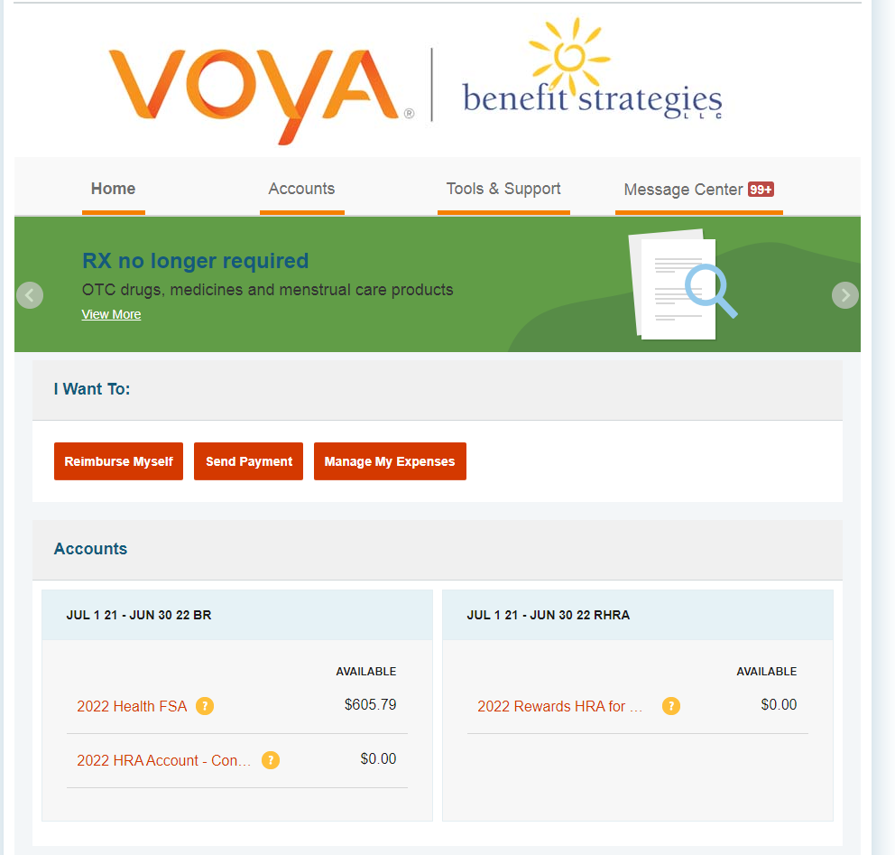
Benefit Strategies (BSL) Portal
Visit www.benstrat.com to access your portal
Select Individual Login
Login: Reimbursements, Rewards, Savings & Spending Accounts
If you have logged in before: enter your username and password and click login
If you have never logged in before: click on the Create your username and password link
The online portal allows you to:
Manage Account Balances
Submit Claims
Manage Tasks
Notes:
Hover over yellow question marks to show full name of plan. It will also show the plan year dates, filing dates and final service dates.
I want to: Reimburse Myself might be your most utilized feature. This will allow you to file a claim.
Send Payment is to make a payment directly to the Provider
Manage my Expenses is a tracking tool to help manage expenses

Slide 18
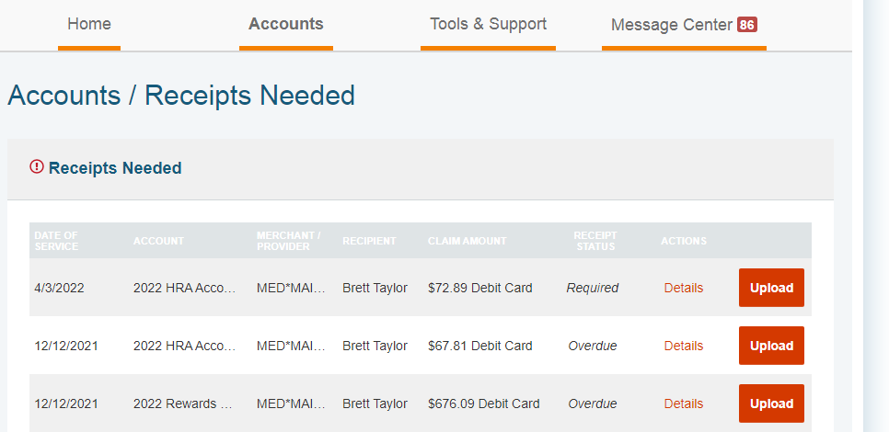
BSL Portal: Tasks
Monitor your claims payments
Track which claims need receipts or repayments
Set up Direct Deposit
5/12/2022 | 2022 HRA Acco. | MED*MAI.. | Timmy Turner | $82.59 | Required | Details
5/01/2022 | 2022 HRA Acco | MED*MAI.. | Timmy Turner | $65.09 | Overdue | Details
3/22/2022 | 2022 Rewards | MED*MAI.. | Timmy Turner | $651.55 | Completed | Details
Notes:
Hover over yellow question marks to show full name of plan. It will also show the plan year dates, filing dates and final service dates.
I want to: Reimburse Myself might be your most utilized feature. This will allow you to file a claim.
Send Payment is to make a payment directly to the Provider
Manage my Expenses is a tracking tool to help manage expenses

Slide 19
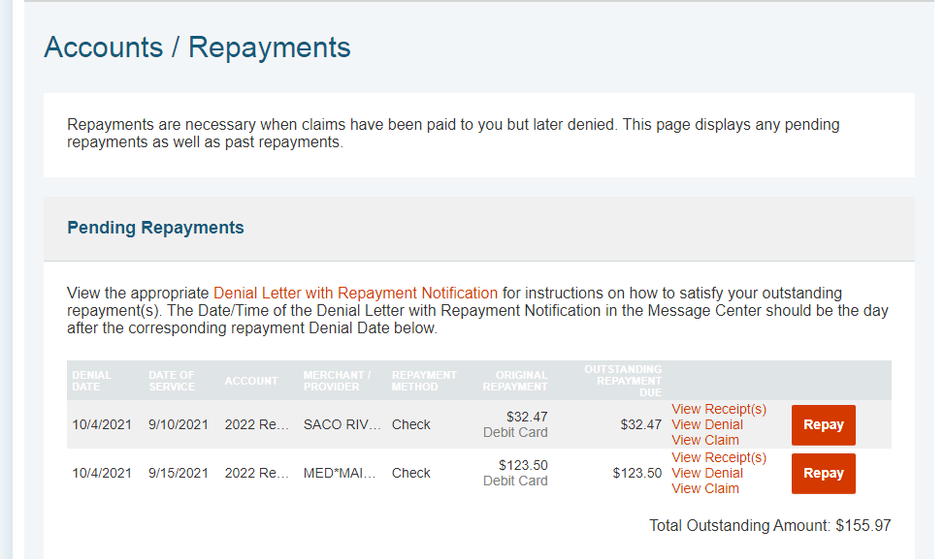
BSL Portal: Repayments
9/9/2021 | 8/31/2021 | 2022 Rew.. | Saco River | Check | $33.57 Debit Card | $33.57
8/9/2021 | 07/1/2021 | 2022 Rew.. | MED*MAI.. | Check | $101.32 Debit Card | $101.32
$134.89
Notes:
Can select the hyperlink of repayments under tasks to pay Benefit Strategies back for denied claims that require reimbursement to get to this page.
Select repay to pay back benefit strategies.
You can not pay back partial amounts, you can only repay the full amount due.

Slide 20
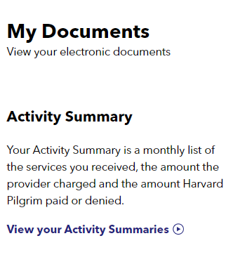
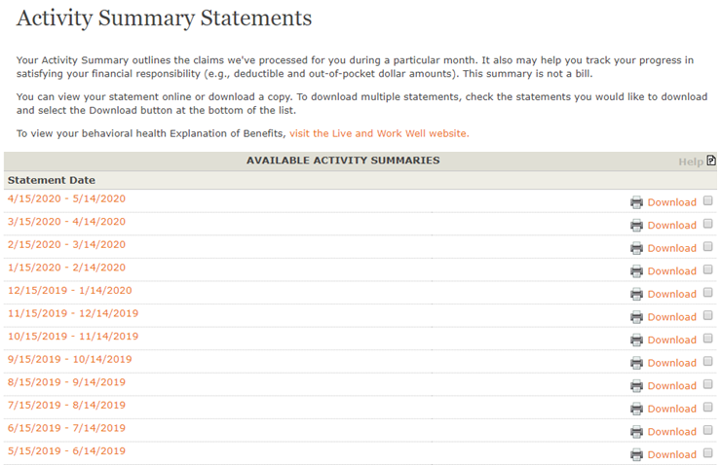

Slide 21
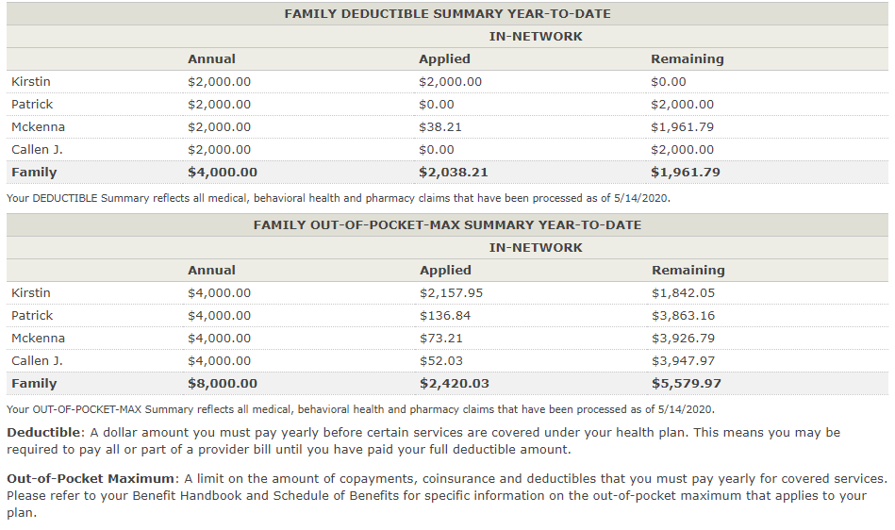
Activity Summary Tracking your out-of-pocket expenses

Slide 22
Additional Benefit Programs
Doctor on Demand. A telemedicine urgent care service for members to utilize that is not only cost effective but also convenient. Medical Visits are Covered in Full!
Trust Work-Life Assistance Program. An Employee Assistance Program (EAP) available to all SAU employees regardless of their enrollment in the health plan.
Reduce My Costs. A healthcare consumer tool used to help identify lower costing medical services and reward members who participate. Members receive 20% of the savings up to a $2000 Maximum.

Slide 23
Questions?
Visit your Open Enrollment Dashboard to complete Activity #2: www.nhitrust.org/SAU9-OE-2022

